Slide 1


SHOPPING NOVA
dept. Computer Softwareline
홍성문 (SungMun Hong)
하선웅 (SeonWoong Ha)
dept. Information System
정하은 (HaEun Jung)
김건우 (GeonU Kim)
Notes:
Hello, I'm seonung-ha from the computer software department in charge of the presentation. Let me start the presentation.

Slide 2

SHOPPING NOVA
CONTENTS
Introduction
04.
Implementation
01.
Service
05.
Challenges
02.
Demo
06.
Future Plan
03.

Slide 3

SHOPPING NOVA
INTRODUCTION
SHOPPING NOVA
1
Where Space Meets Shopping
Immersive 3D Shopping Adventure
2
Notes:
My team worked on a project with a theme that combined online shopping and 3D space exploration. I believe that through this project, shopping can be a special experience, not just a transaction for customers.

Slide 4
SHOPPING NOVA
OUR TEAM
BACKGROUND
Motivation
Outdated UI/UX Challenge
Modernization Opportunity
Goal
Revitalized Shopping Experience Interactive 3D Platform
Cosmic Shopping Journey
FRONT-END
UI & UX
BACK-END
Introduction
Notes:
Our team consists of two back-end developers and two front-end developers. Our team's goal is to develop the traditional online environment to keep up with the latest web market trends.
The motivation for the project started with the old-fashioned uiux of the existing lg electronics website. We wanted to modernize the interface of this website. We wanted to create an interactive platform for our customers. Therefore, we integrated three-dimensional spaces to provide customers with an enjoyable shopping experience while exploring a virtual space world full of products, making shopping feel like an exciting experience.

Slide 5
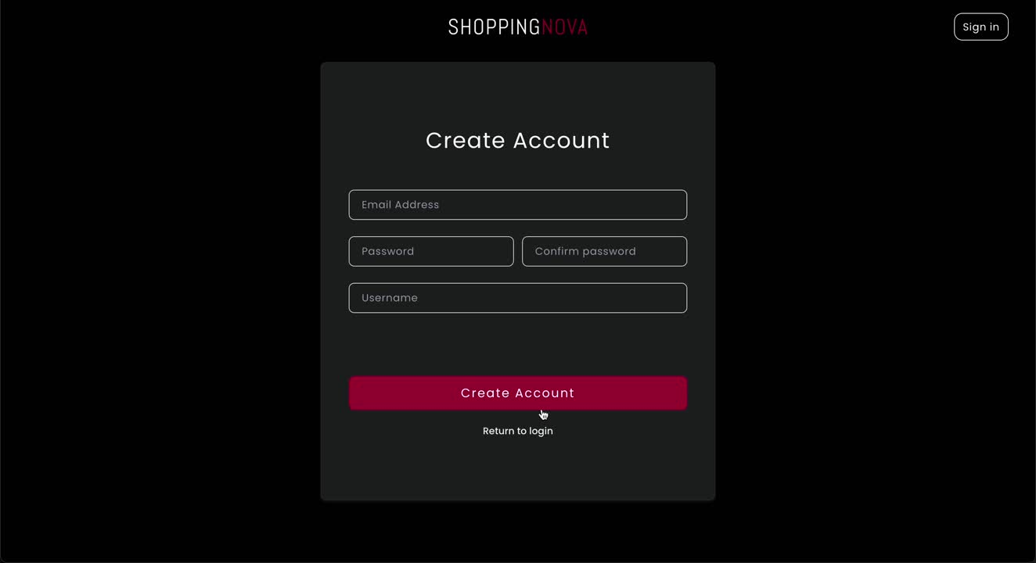
SHOPPING NOVA
DEMO
Notes:
Now, let’s watch a short demo video that shows our platform in action.
When you click the 'Sign In' button in the header, the login page appears.
From the login page, you can also navigate to the signup page.
After a successful login, you will be directed to the main page, which displays the highest depth categories.
Clicking on one of the categories allows you to view subcategories, and you can repeat the same action.
The product list is represented by stars in a three-dimensional space.
When you hover over a product, a product information popup will appear.
Clicking on the star will take you to the detailed information page about that product.
By clicking the 'Cart' button, users can add products to their cart.
Lastly, on the cart page, users can see the products they have added to their cart.
Users can also add or remove products from the cart.

Slide 6
SHOPPING NOVA
Service
Notes:
Now, let’s dive into the details of our service.

Slide 7
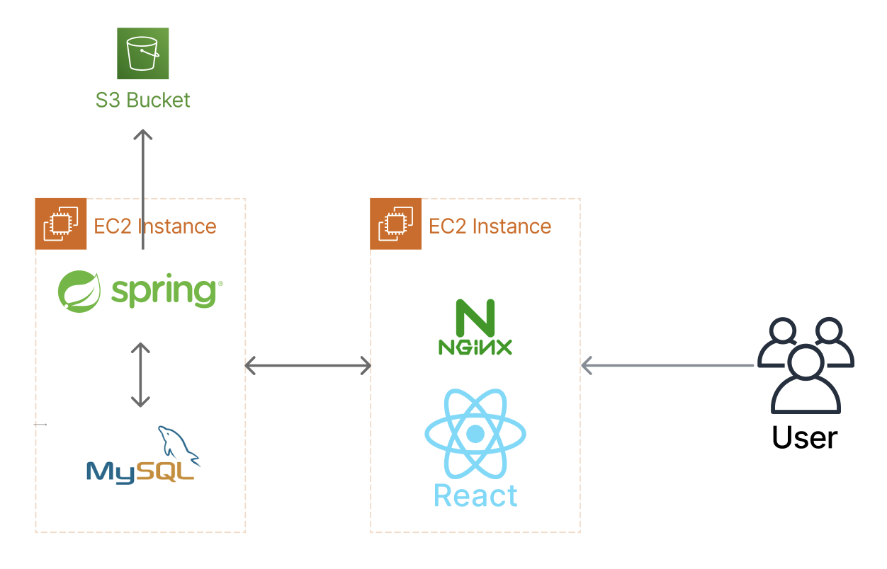
SHOPPING NOVA
SERVICE
SYSTEM ARCHITECTURE & TECHNICAL STACK
Front-End
React & Vite, Nginx
Hosted on AWS EC2
Back-End
Spring Boot, MySQL
Deployed on AWS EC2
Static File Storage
Amazon S3
Communication
Restful API
Notes:
Here is the integrated architecture of our services. At the front end, the development was done using react and vite. It also used nginx for static web hosting. we use Spring Boot, a lightweight and versatile framework that powers our application logic and API endpoints. The data about user, product managed in a MySQL database, providing a secure and structured storage solution. The front-end and back-end are built and distributed in aws ec2 instances, respectively. We are also using aws3 to enable scalable media storage to host static files such as product images.The frontend communicates with the backend through a RESTful API. This architecture ensures a clean separation of concerns, allowing each layer to operate independently while maintaining cohesive functionality.

Slide 8
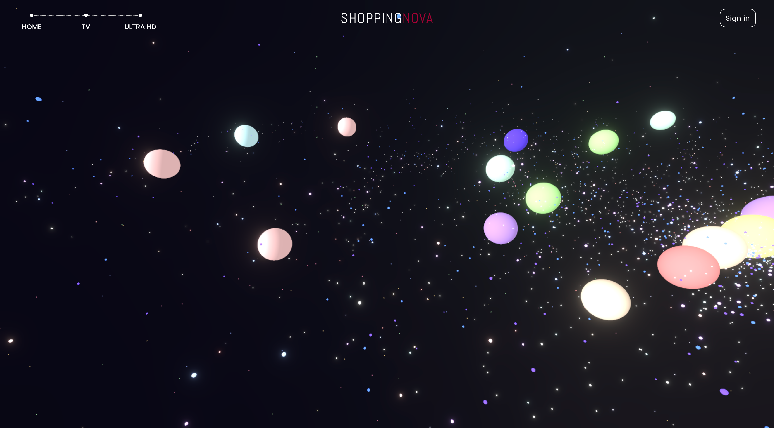
SHOPPING NOVA
Tech Used
Three.js
- Products as Stars in Celestial Space
- Render 3D Objects through WebGL
Notes:
I'll continue with the description of threejs. We use threejs, which allows us to render 3d objects on the web, to integrate 3d space into our shopping mall. We're mapping categories to galaxies, commodities to stars, showing 3d space, and we wanted to give you the experience of exploring real space through dynamic camera movement.

Slide 9
SHOPPING NOVA
UI & UX
Space Theme - Products as Stars in Celestial Space
Shopping with 3D universe exploration
Intuitive controls for easy navigation and interaction with products
Service
Notes:
The implementation of our UI/UX is centered around the space theme. Users can navigate through a 3D universe where products are represented as stars and celestial objects. This innovative approach not only makes shopping fun but also encourages exploration. We have designed intuitive controls that allow users to easily browse and interact with products, enhancing their overall experience.

Slide 10
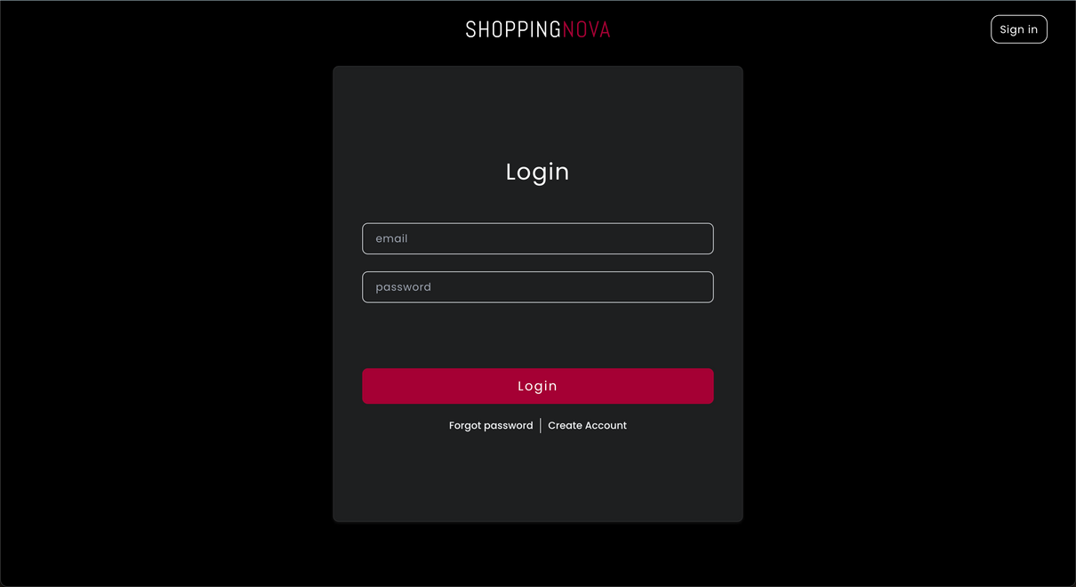
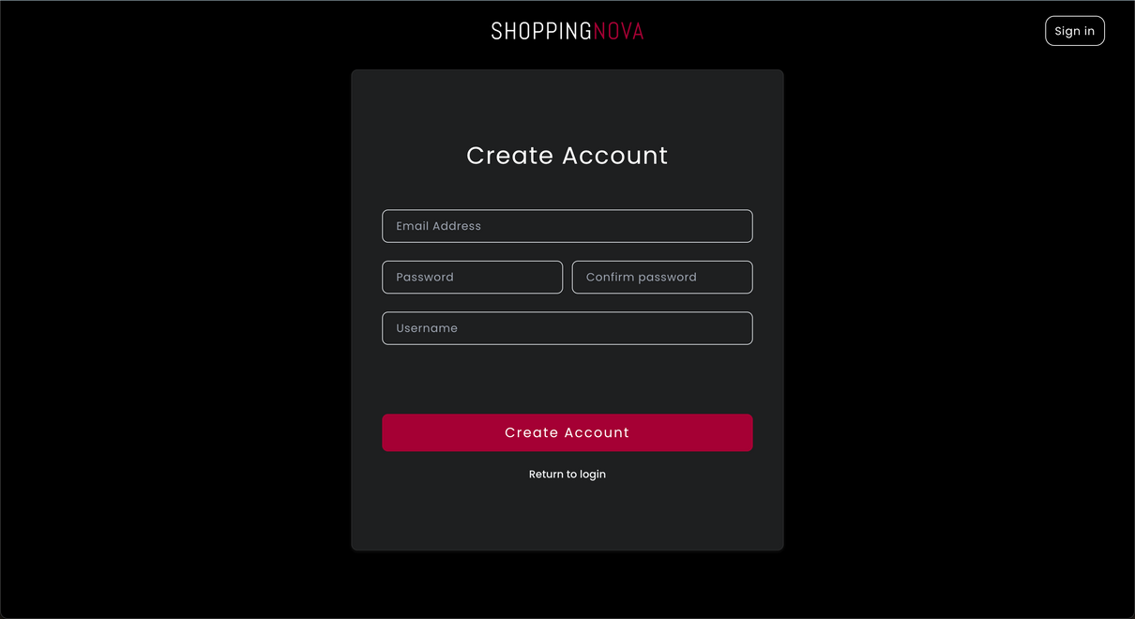
SHOPPING NOVA
IMPLEMENTATION
1
2
Login Page
Sign Up Page
Notes:
This is

Slide 11
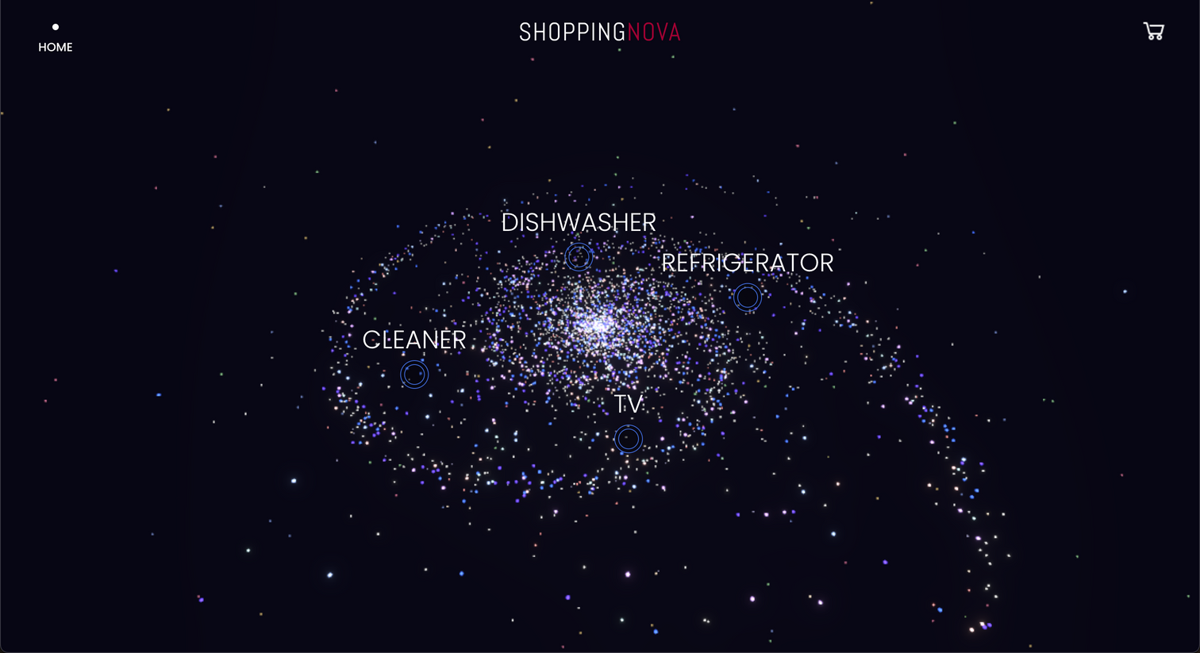
SHOPPING NOVA
3
Main Page
Implementation

Slide 12
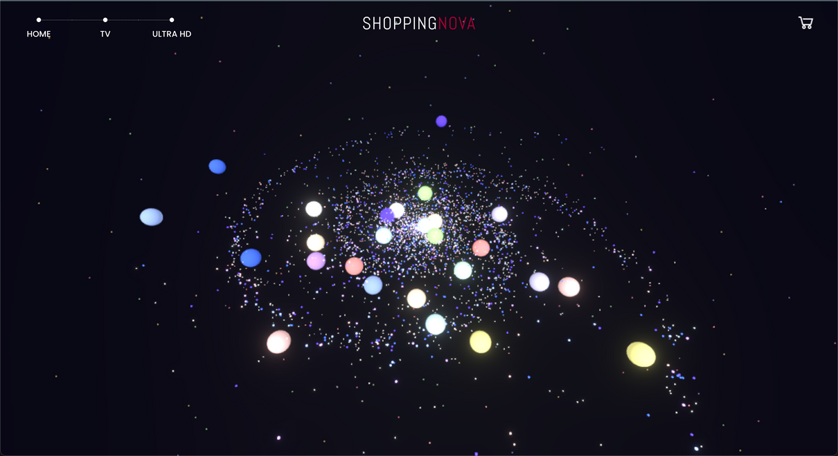
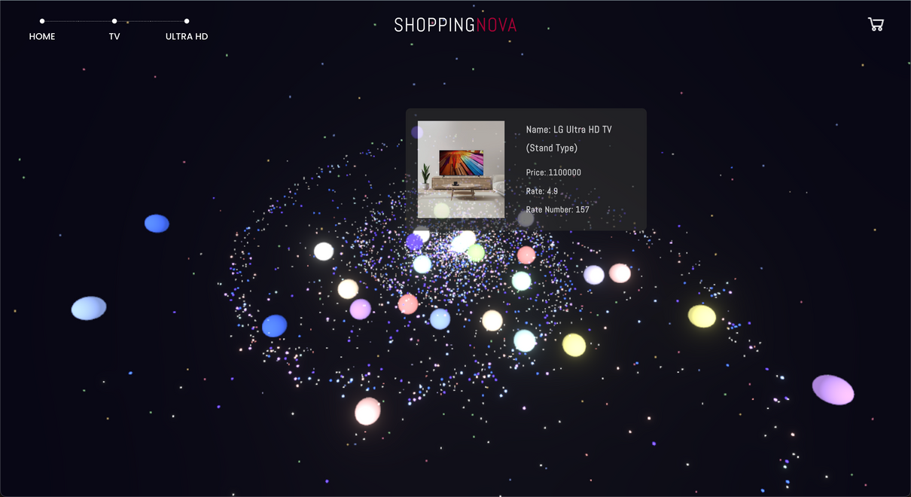
SHOPPING NOVA
4
5
Product List Page
Product Information Pop-Up
Implementation

Slide 13
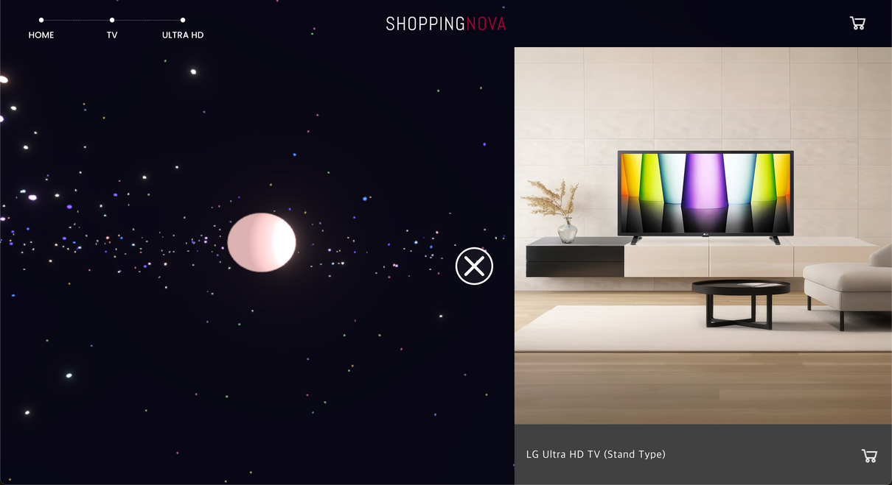
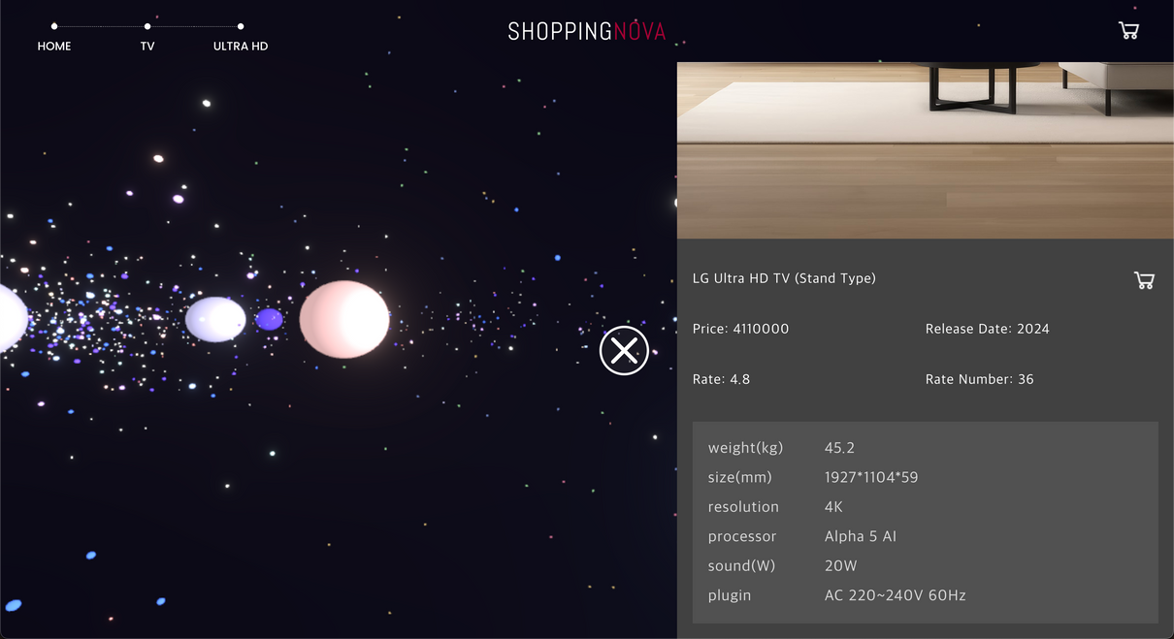
SHOPPING NOVA
6
Product Detail Information Page
Implementation

Slide 14
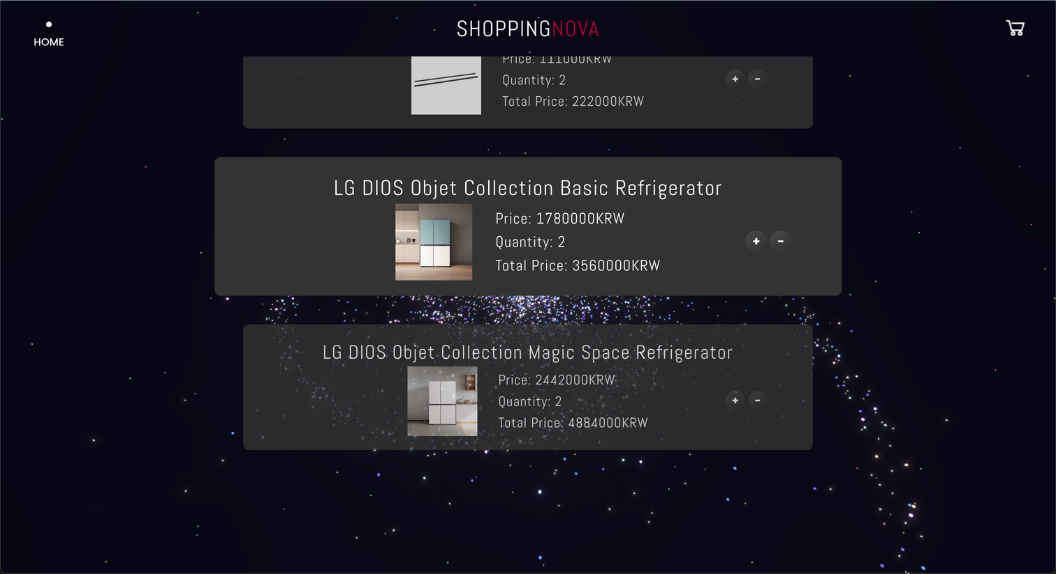
SHOPPING NOVA
7
Cart Page
Implementation

Slide 15
SHOPPING NOVA
SERVICE
Implementation

Slide 16
SHOPPING NOVA
CHALLENGES
LIMITATION 1
LIMITATION 2
Performance Issues
on Three.js
Optimizing Three.js implementation
Capacity Issues
on our AWS EC2
Refining backend
queries
Notes:
In conclusion, we have successfully integrated a 3D space into an online shopping website, providing users with a surprising experience. Our platform reimagines shopping as an exciting adventure, allowing users to explore a universe of products through an intuitive and visually captivating interface.
However, despite these achievements, we recognize several limitations that need to be addressed for further improvement.
Some challenges we faced include performance issues related to Three.js, which can impact rendering speed, and optimization problems with backend queries that have led to capacity issues on our AWS EC2 instances. These challenges have highlighted areas where we need to improve.
Moving forward, we plan to address these limitations by optimizing our Three.js implementation to enhance performance, refining our backend queries for better efficiency, and exploring scalable solutions for our cloud infrastructure.

Slide 17
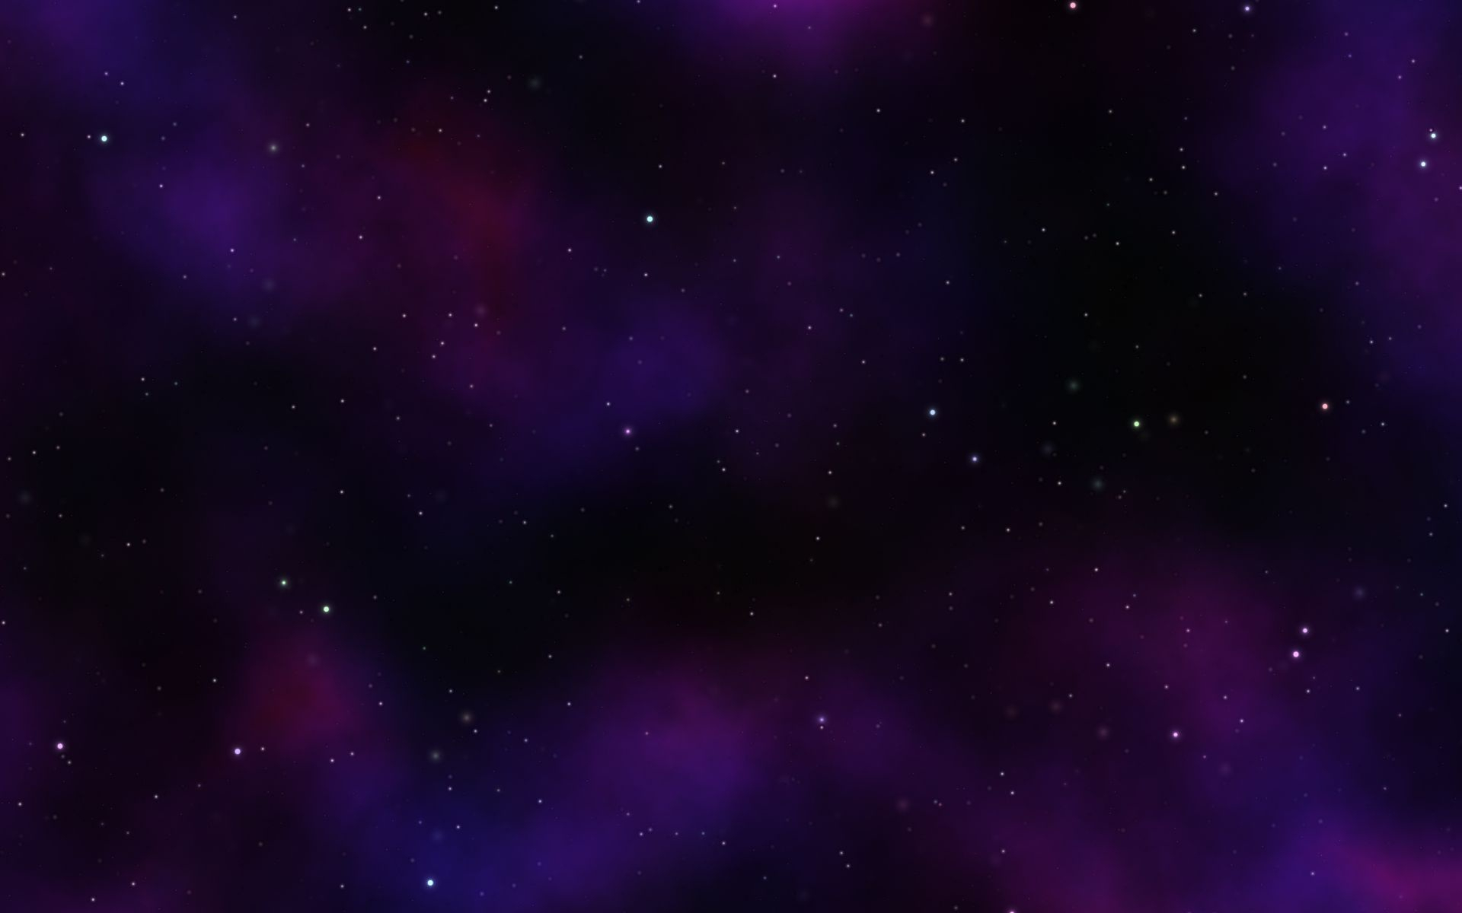
SHOPPING NOVA
FUTURE PLAN
AI-DRIVEN RECOMMENDATIONS
Connect "stars" (products) intelligently using AI-driven recommendation algorithms.
ADMIN CAPABILITIES ENHANCE
Allow admins to append products under new categories.
Allow admins to create and link new "galaxies" (categories) to the existing e-commerce platform.
Notes:
For last, the future plans of our project.
The first one is AI-Driven Recommendation System.
we plan to introduce a recommendation system powered by AI. By connecting our products, or "stars," using AI algorithms, we will provide personalized product recommendations to users. This will help us tailor the shopping experience and improve customer satisfaction.
And the second one is Enhanced Admin Capabilities
Lastly, we aim to strengthen the scalability of our project. While the platform currently supports a limited range of products like refrigerators and TVs, as the number of registered products and categories grows, we plan to make "galaxy" creation more flexible. Admins will be able to create new galaxies and seamlessly integrate them into the existing platform, turning ShoppingNova into a dynamic and adaptable template system.
With these plans, we believe our platform will evolve into a more convenient, intelligent, and scalable ecosystem. Thank you.

Slide 18
SHOPPING NOVA
Q&A
Notes:
Any Question?

